Slide 1
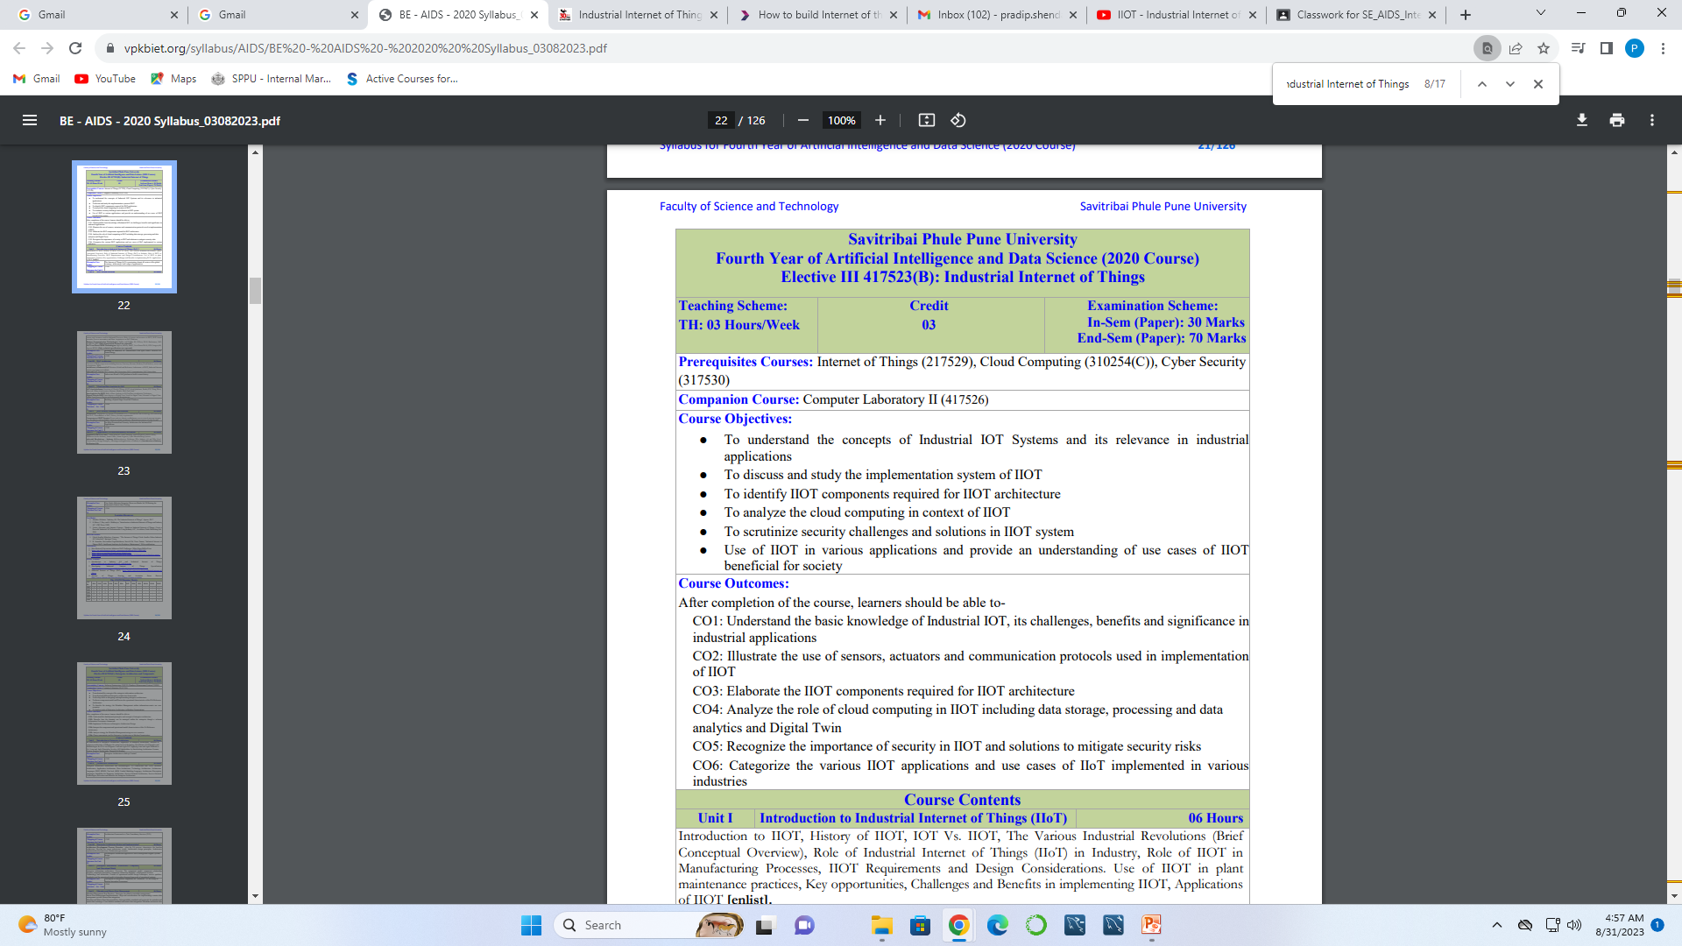

Slide 2
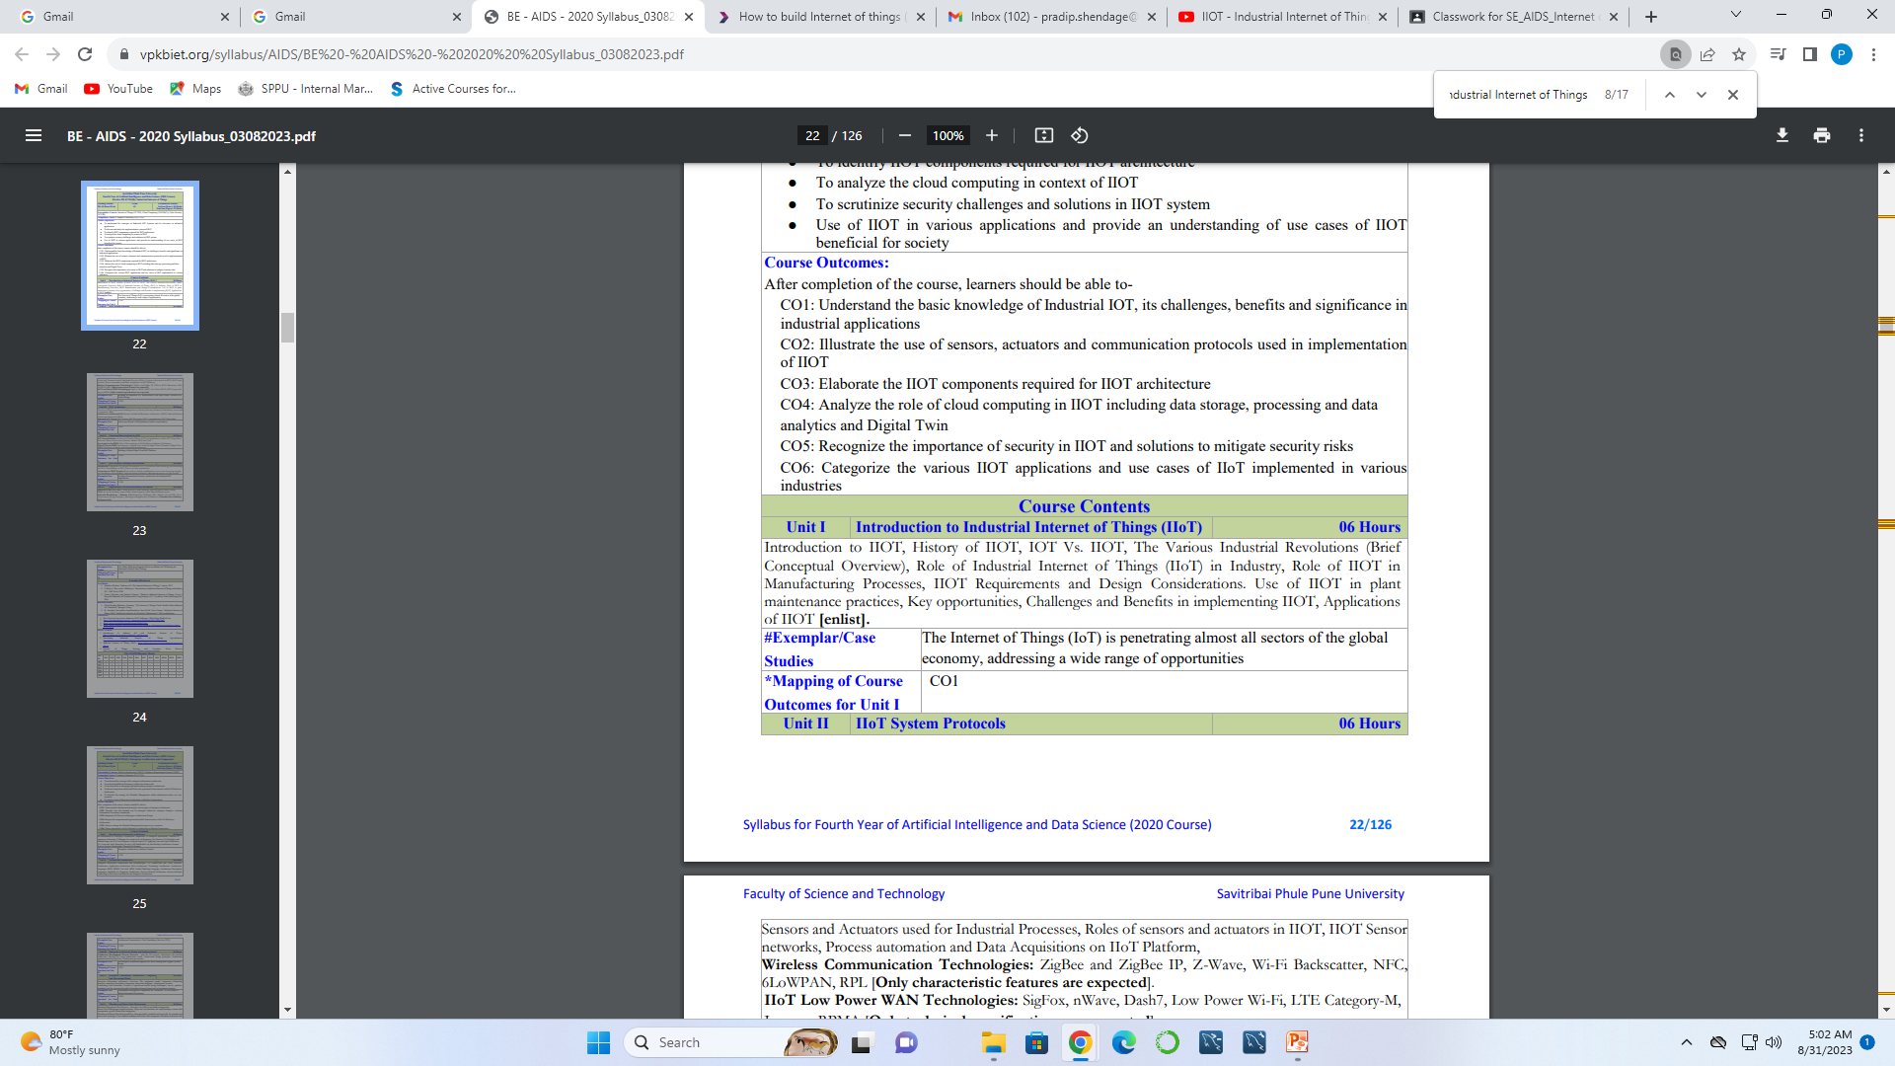

Slide 3
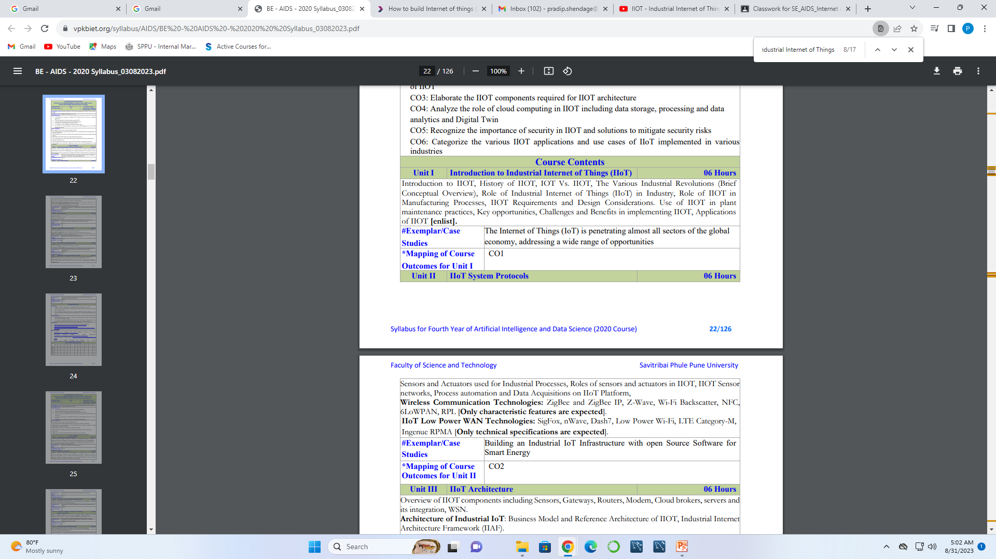

Slide 4
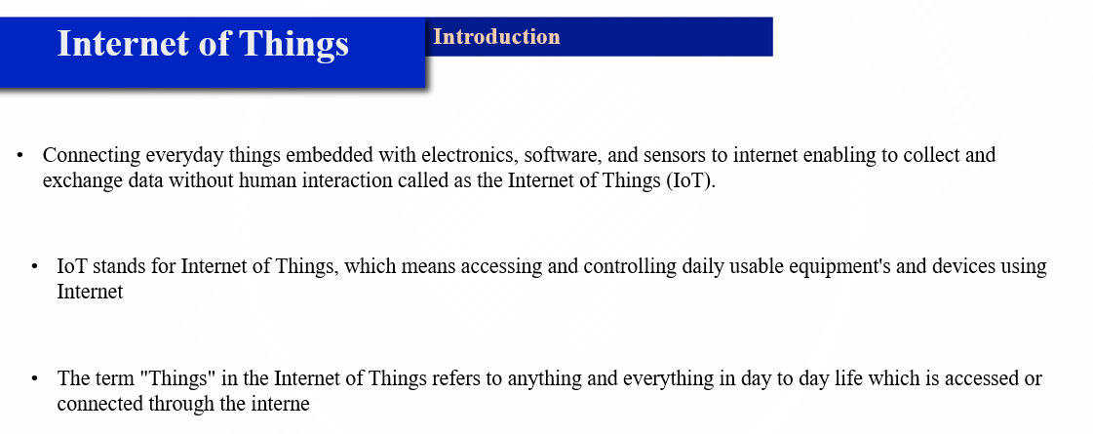

Slide 5
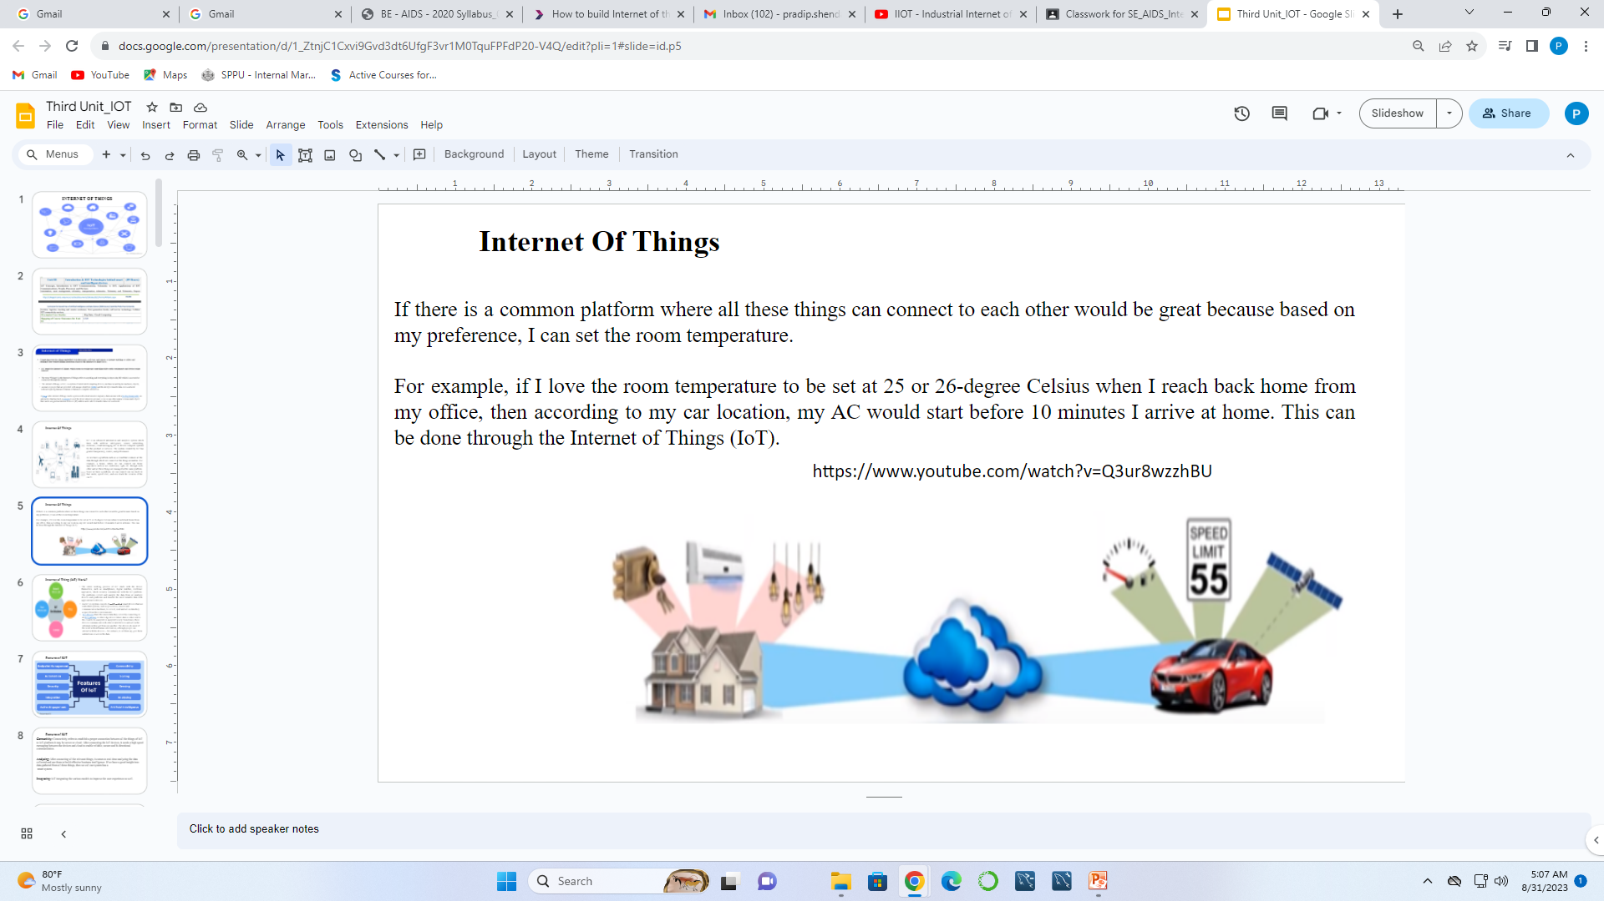

Slide 6
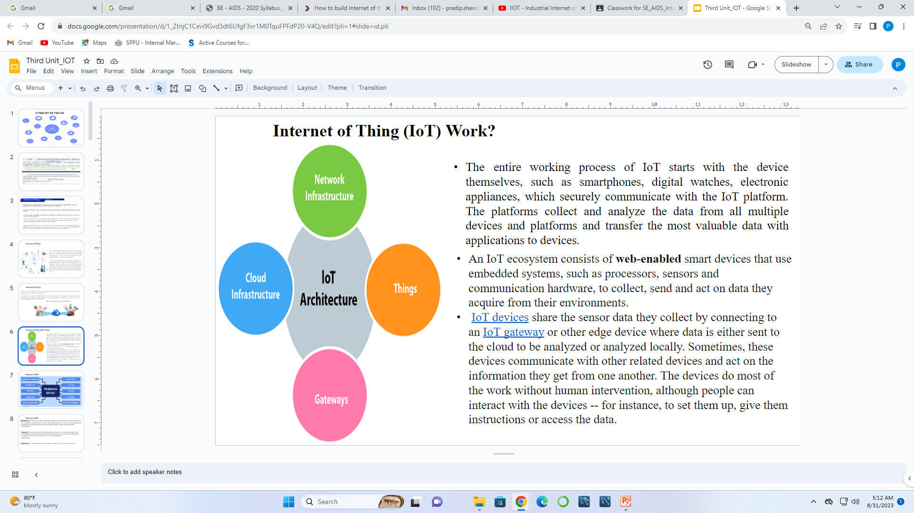

Slide 7
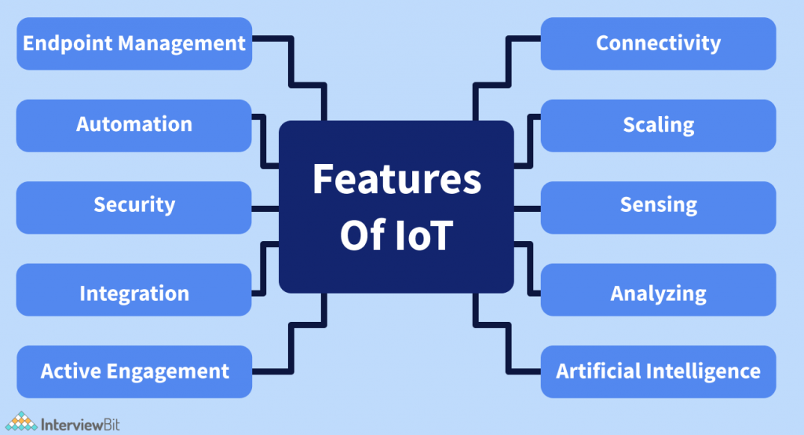
Features of IOT

Slide 8
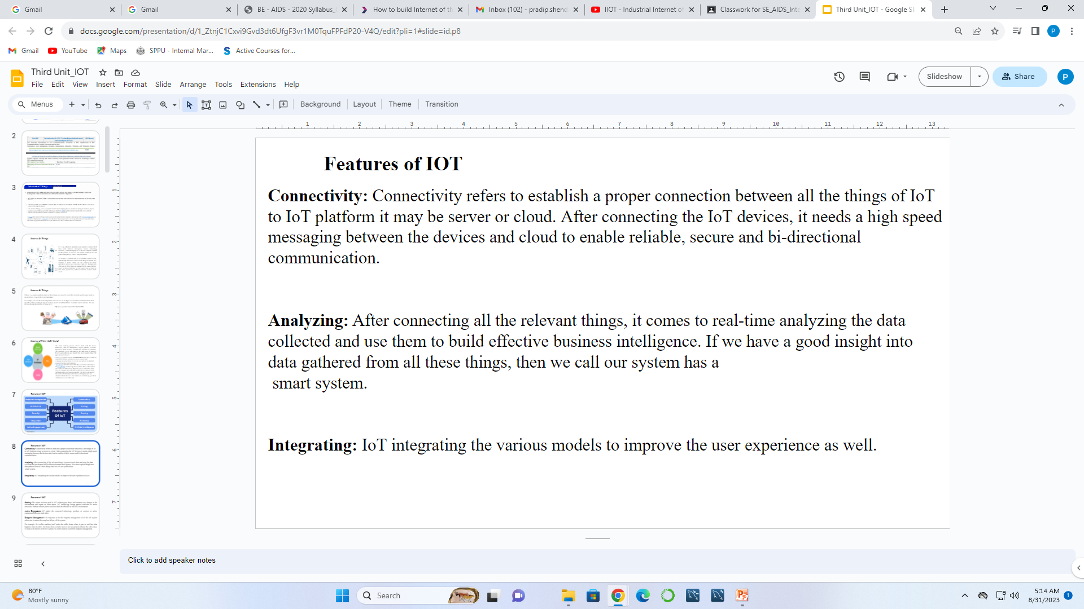

Slide 9
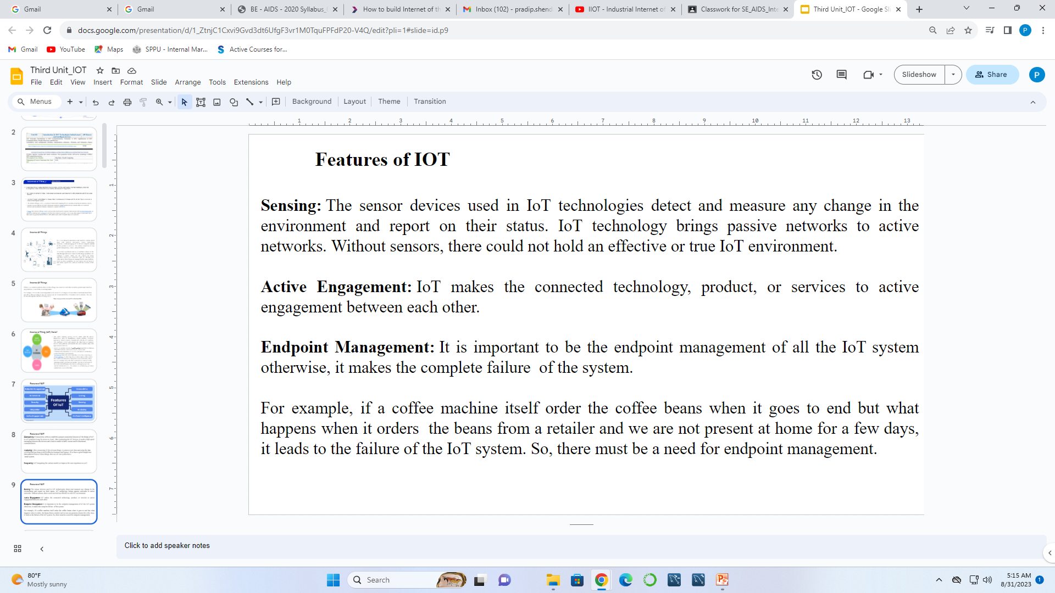

Slide 10
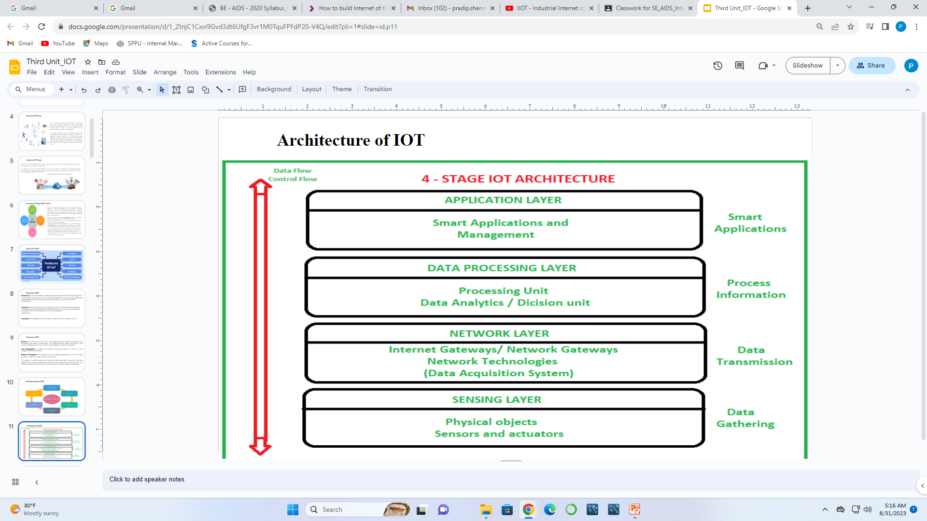

Slide 11
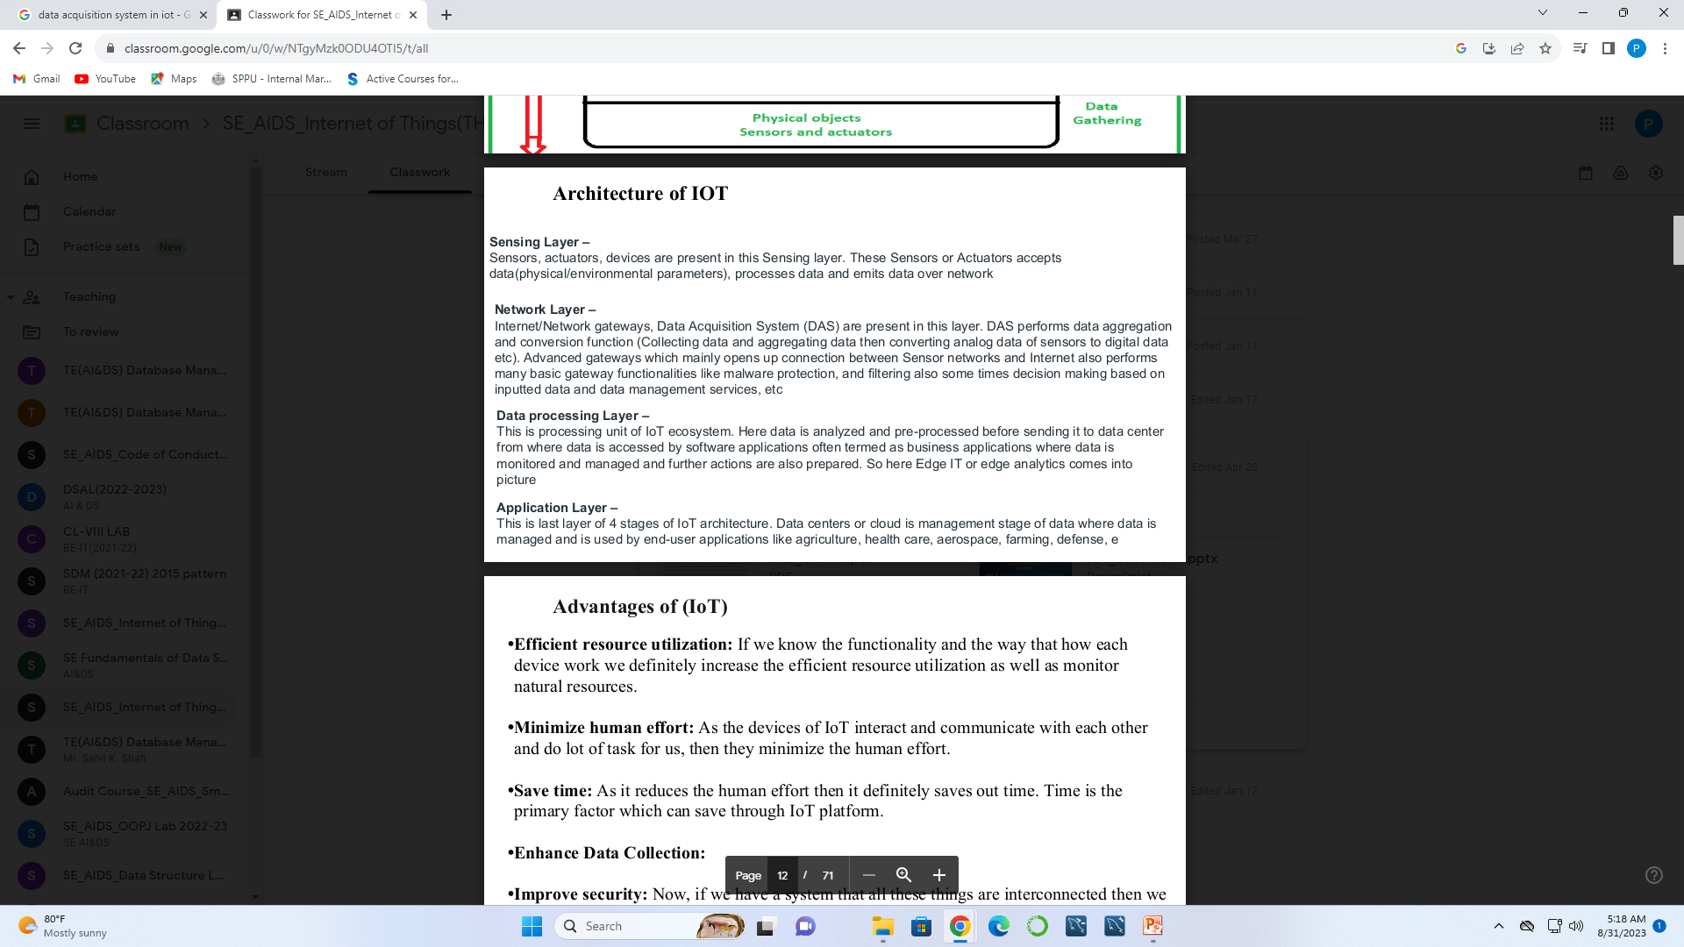

Slide 12
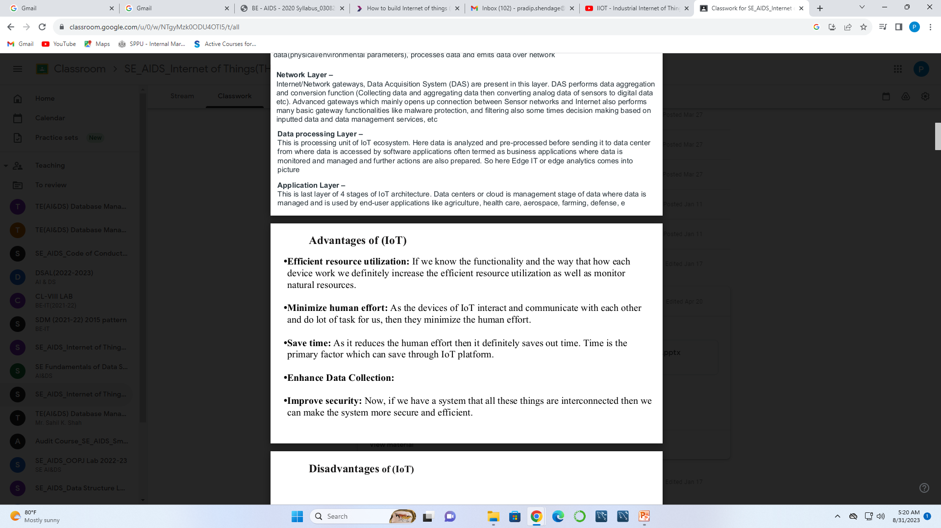

Slide 13
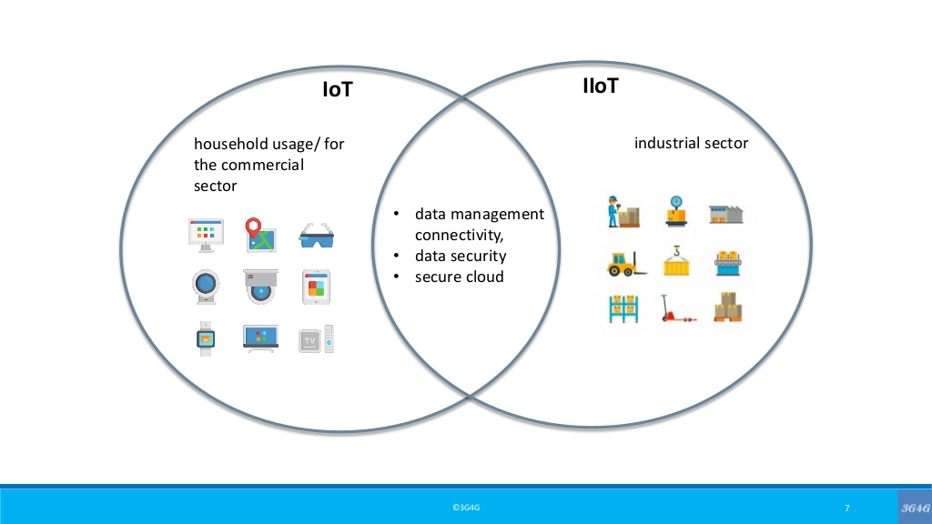

Slide 15
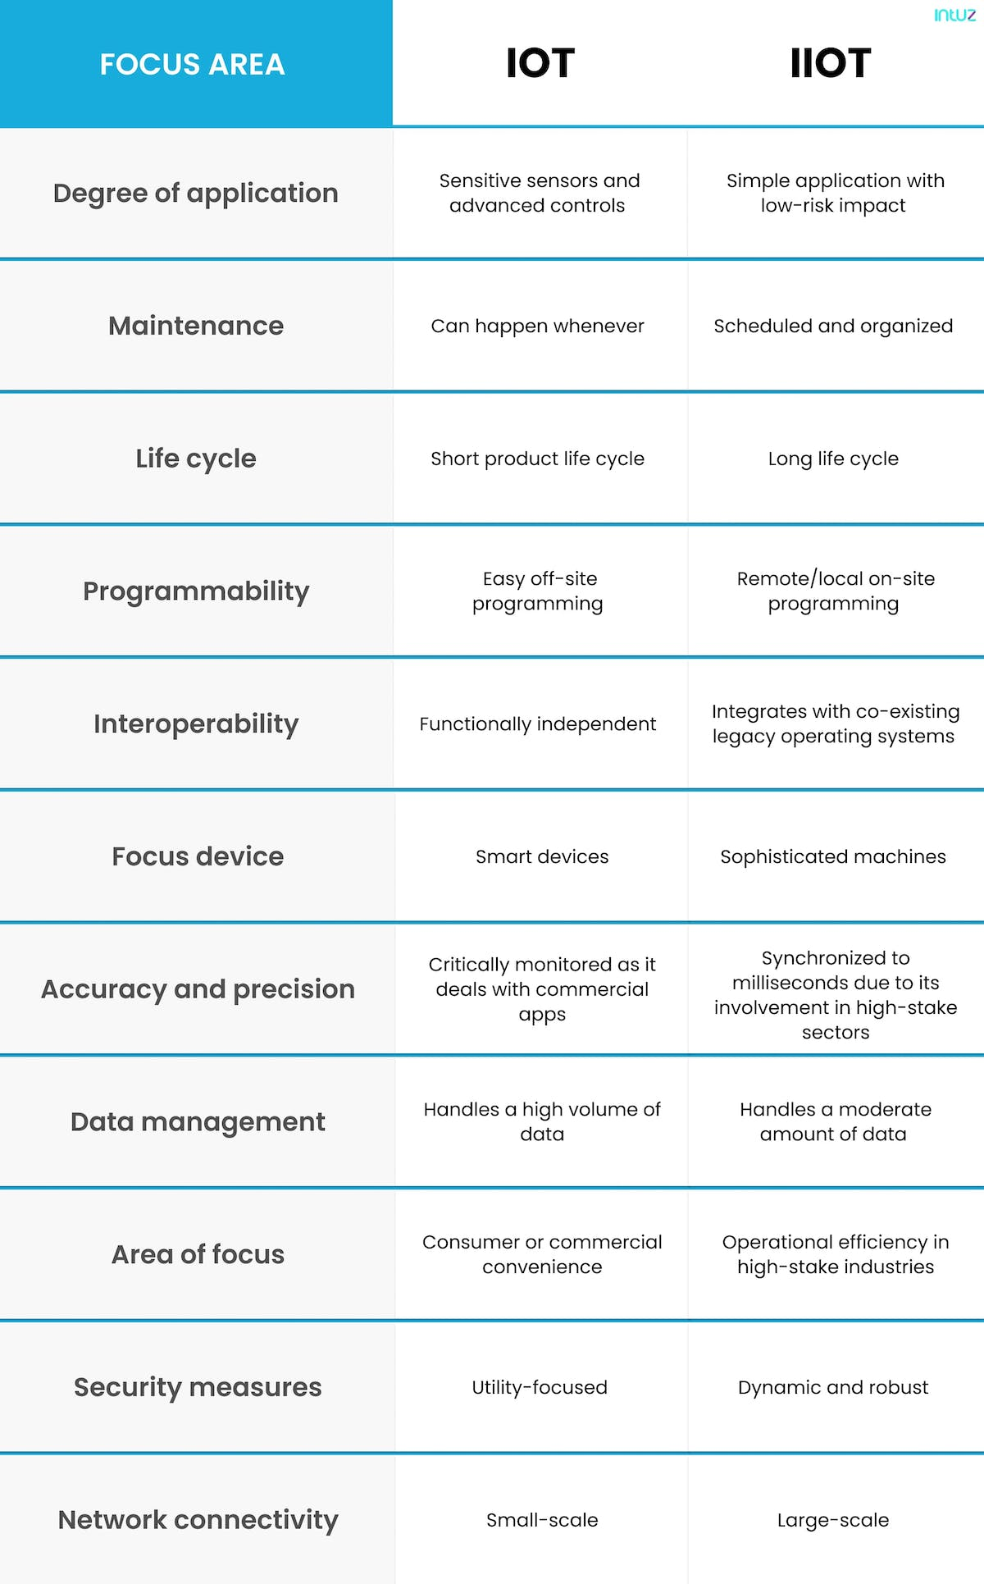

Slide 17
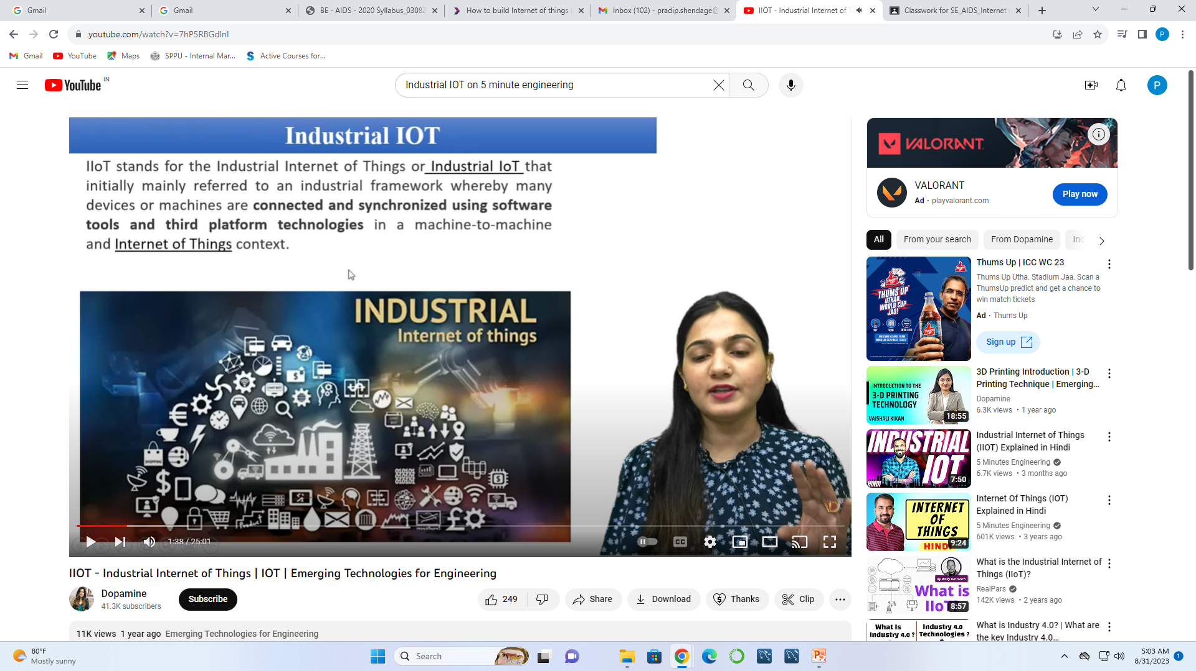

Slide 18
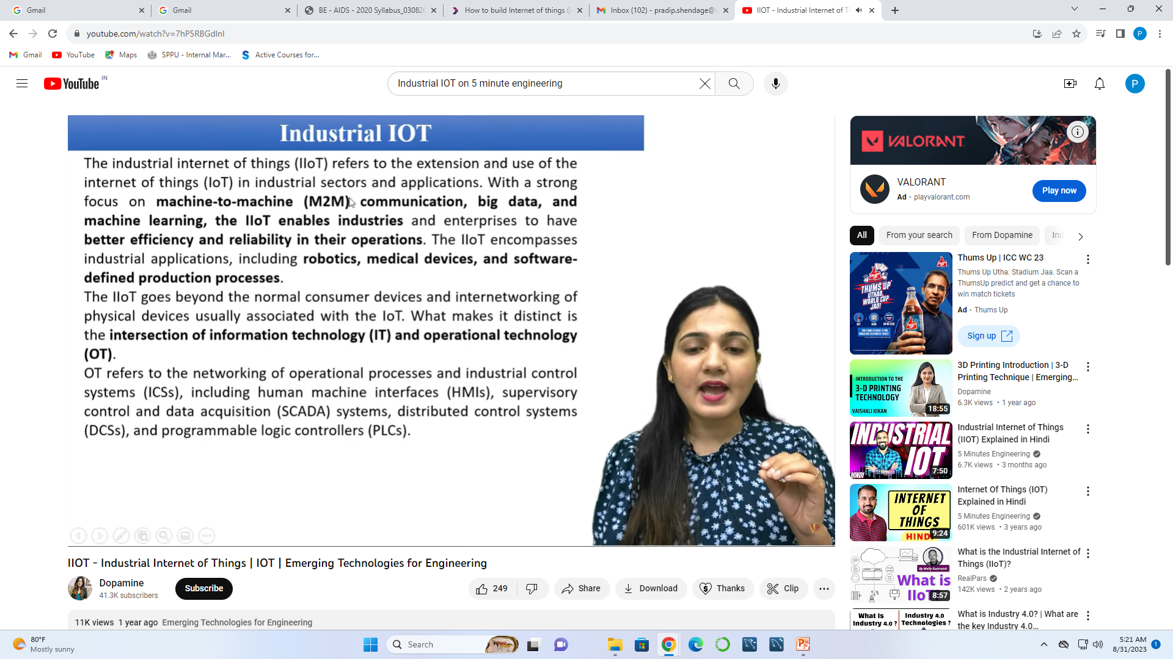

Slide 19



Slide 20


Slide 21


Slide 22
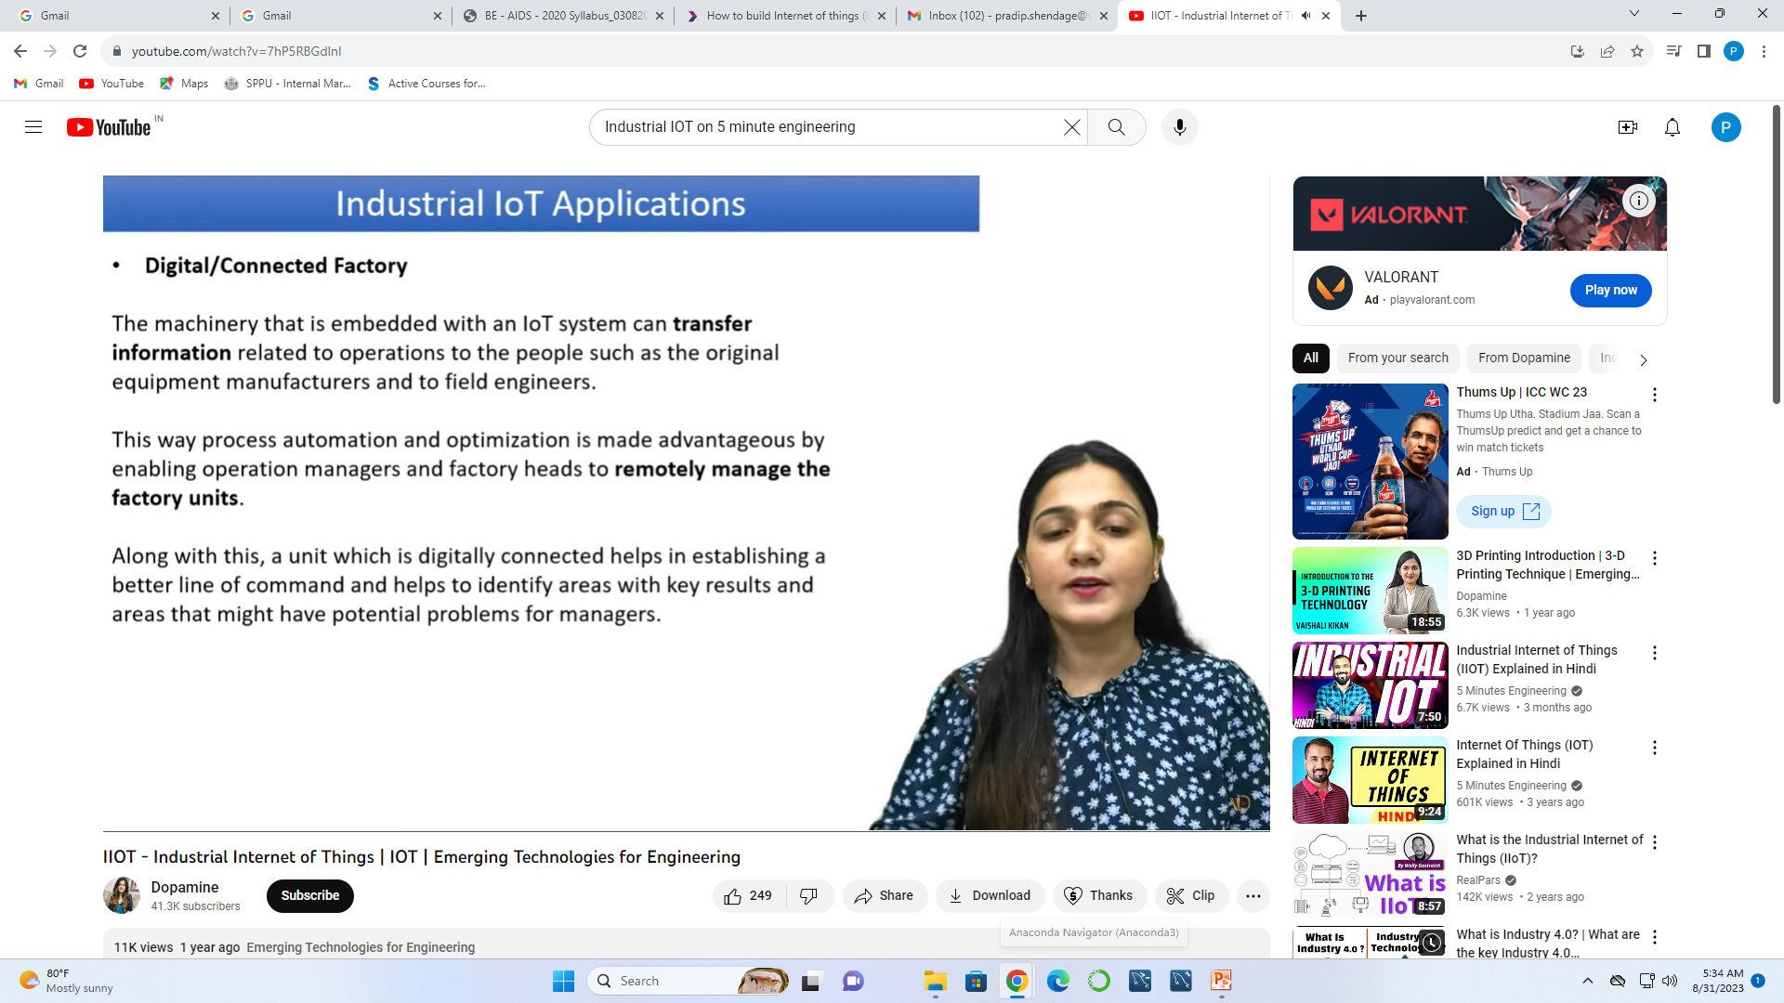

Slide 23


Slide 24


Slide 25


Slide 26


Slide 27


Slide 28
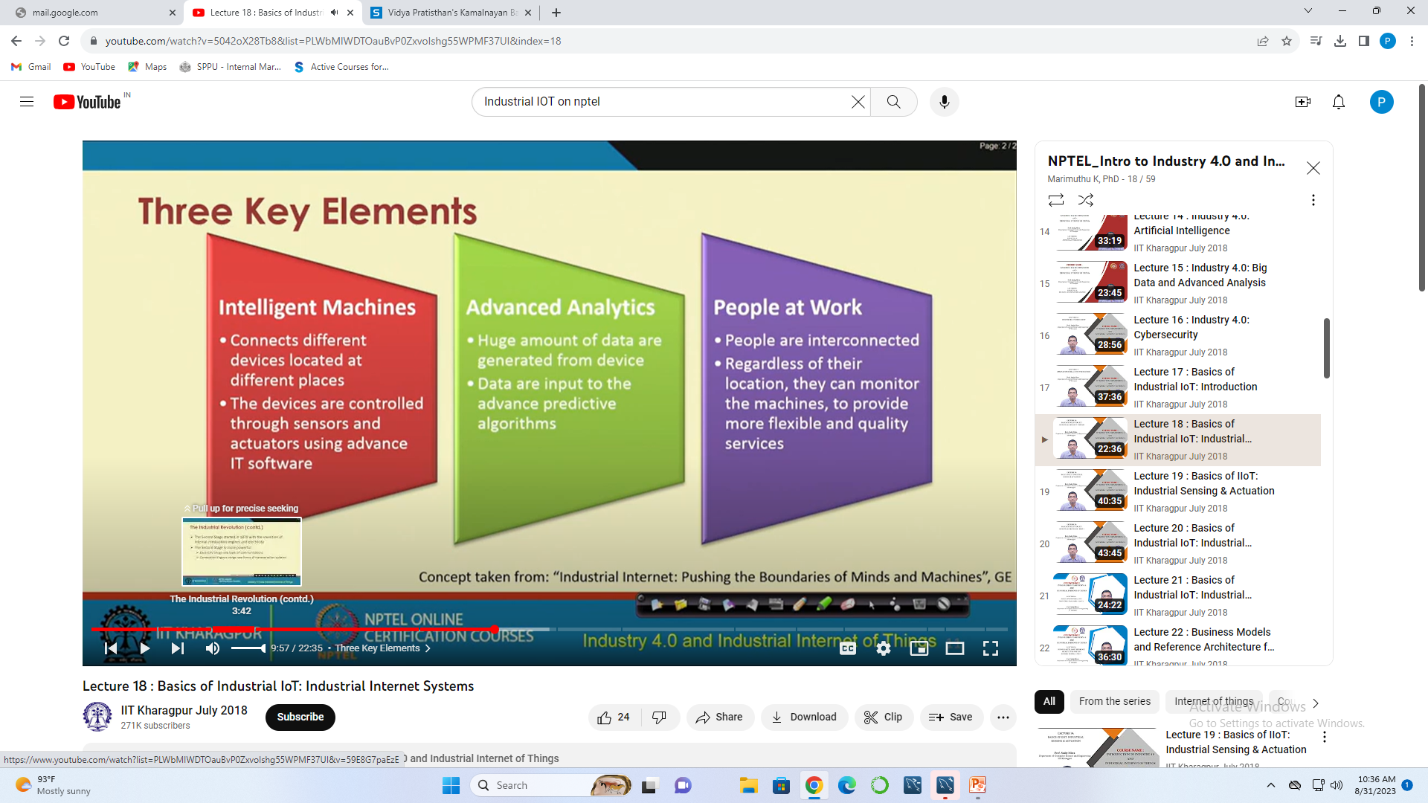

Slide 29
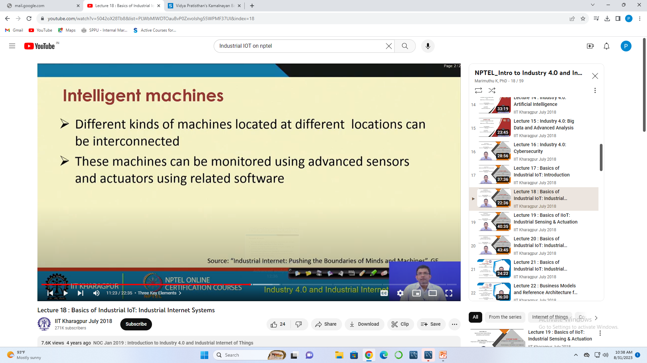
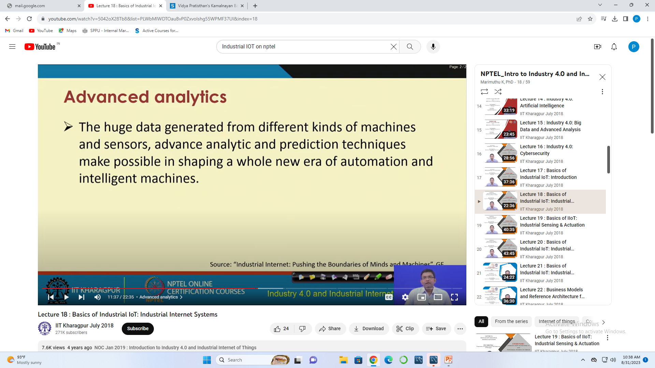

Slide 30
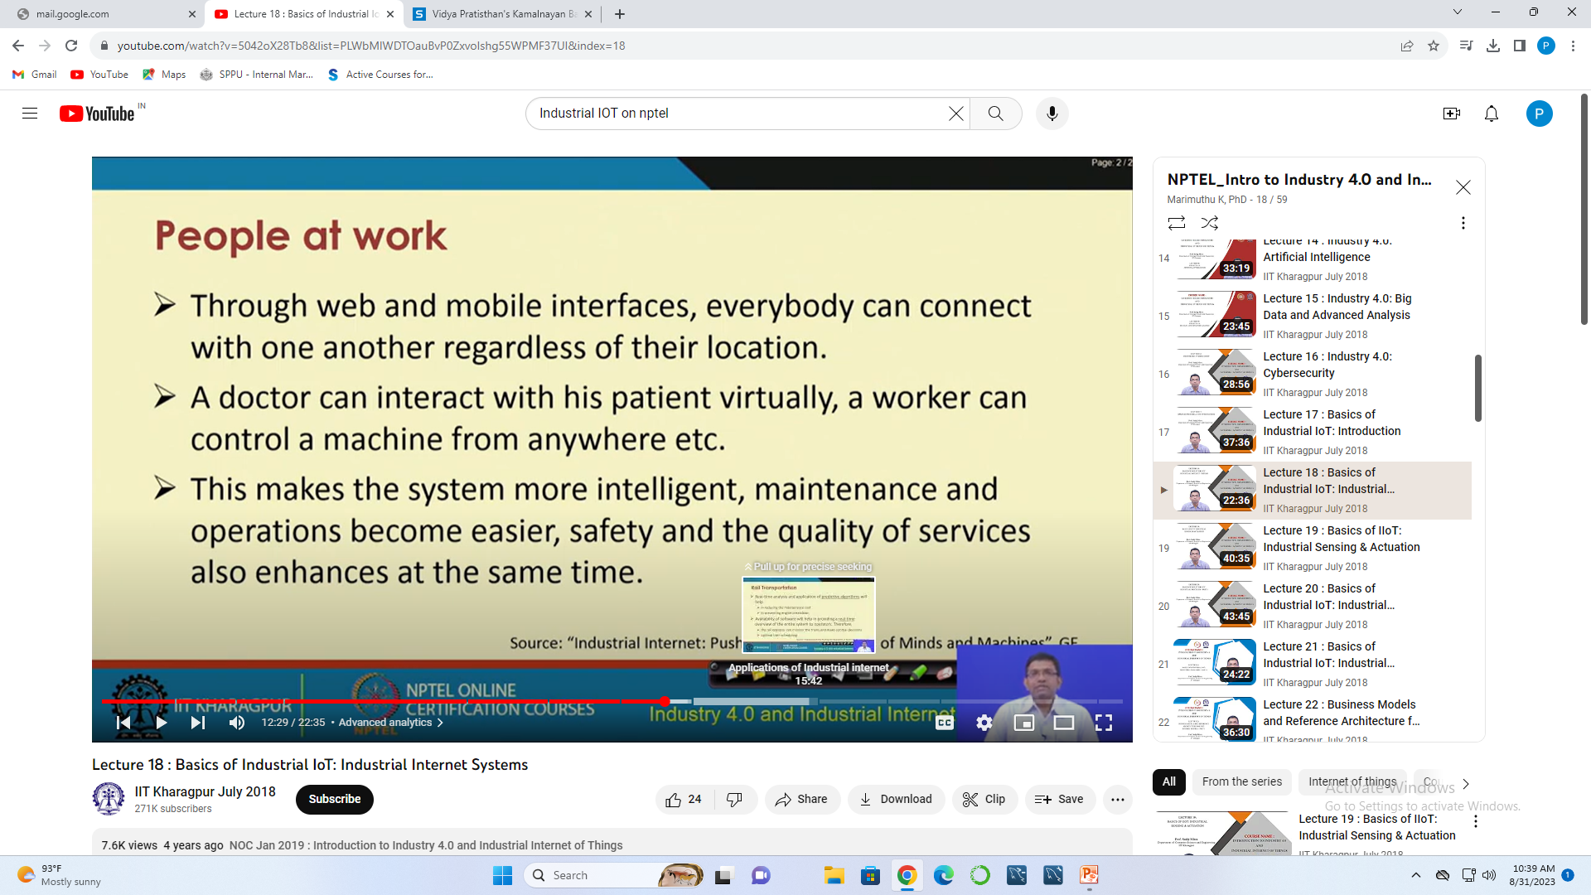

Slide 31
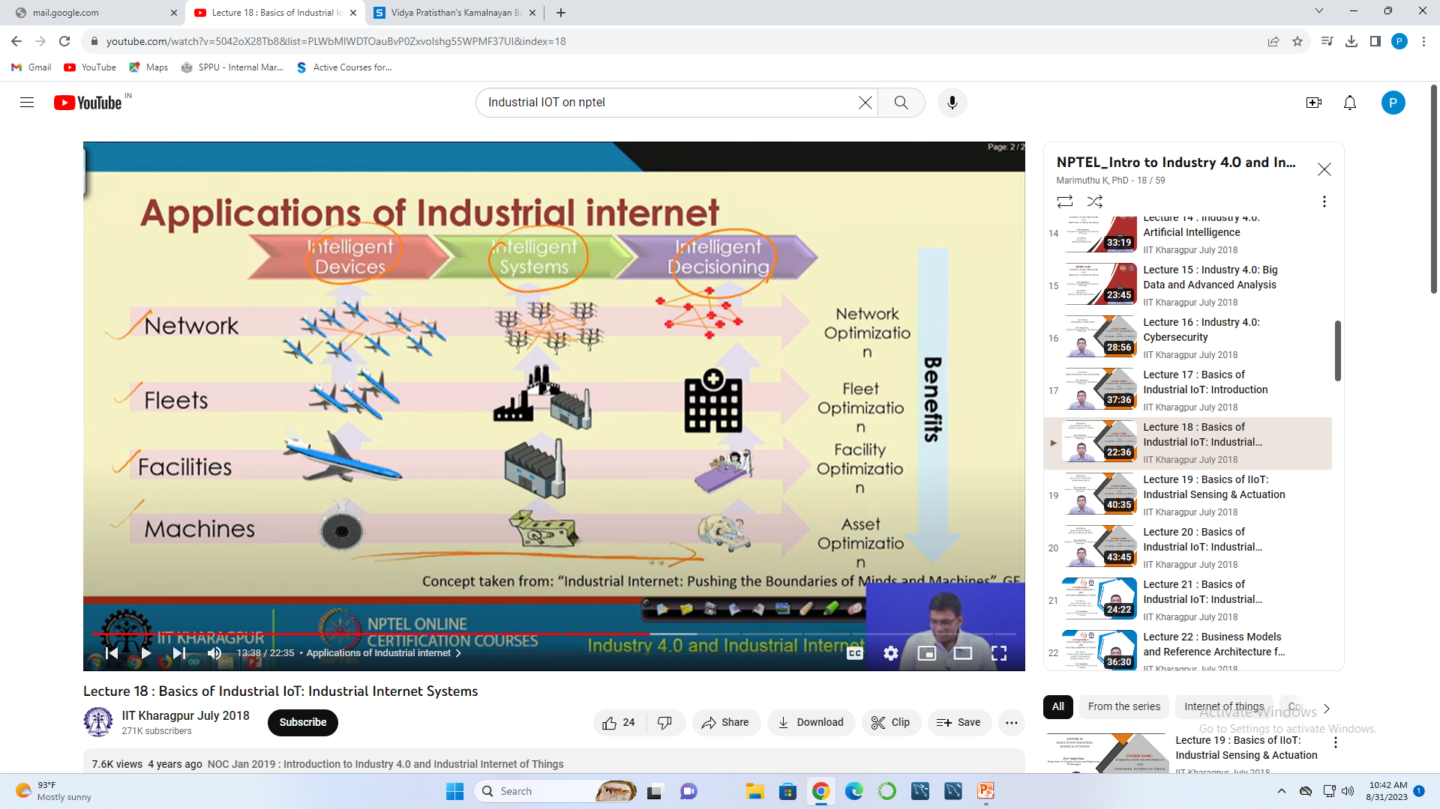

Slide 32
The Role of Industrial IOT
Refers “ Integration of physical industrial devices with internet-connected sensors, software, and other technologies to enable data collection, analysis, and automation in various industrial sectors ”
It combines traditional industries with the power of data, analytics, and connectivity to improve operational efficiency, enhance decision-making processes, and drive innovation.

Slide 33
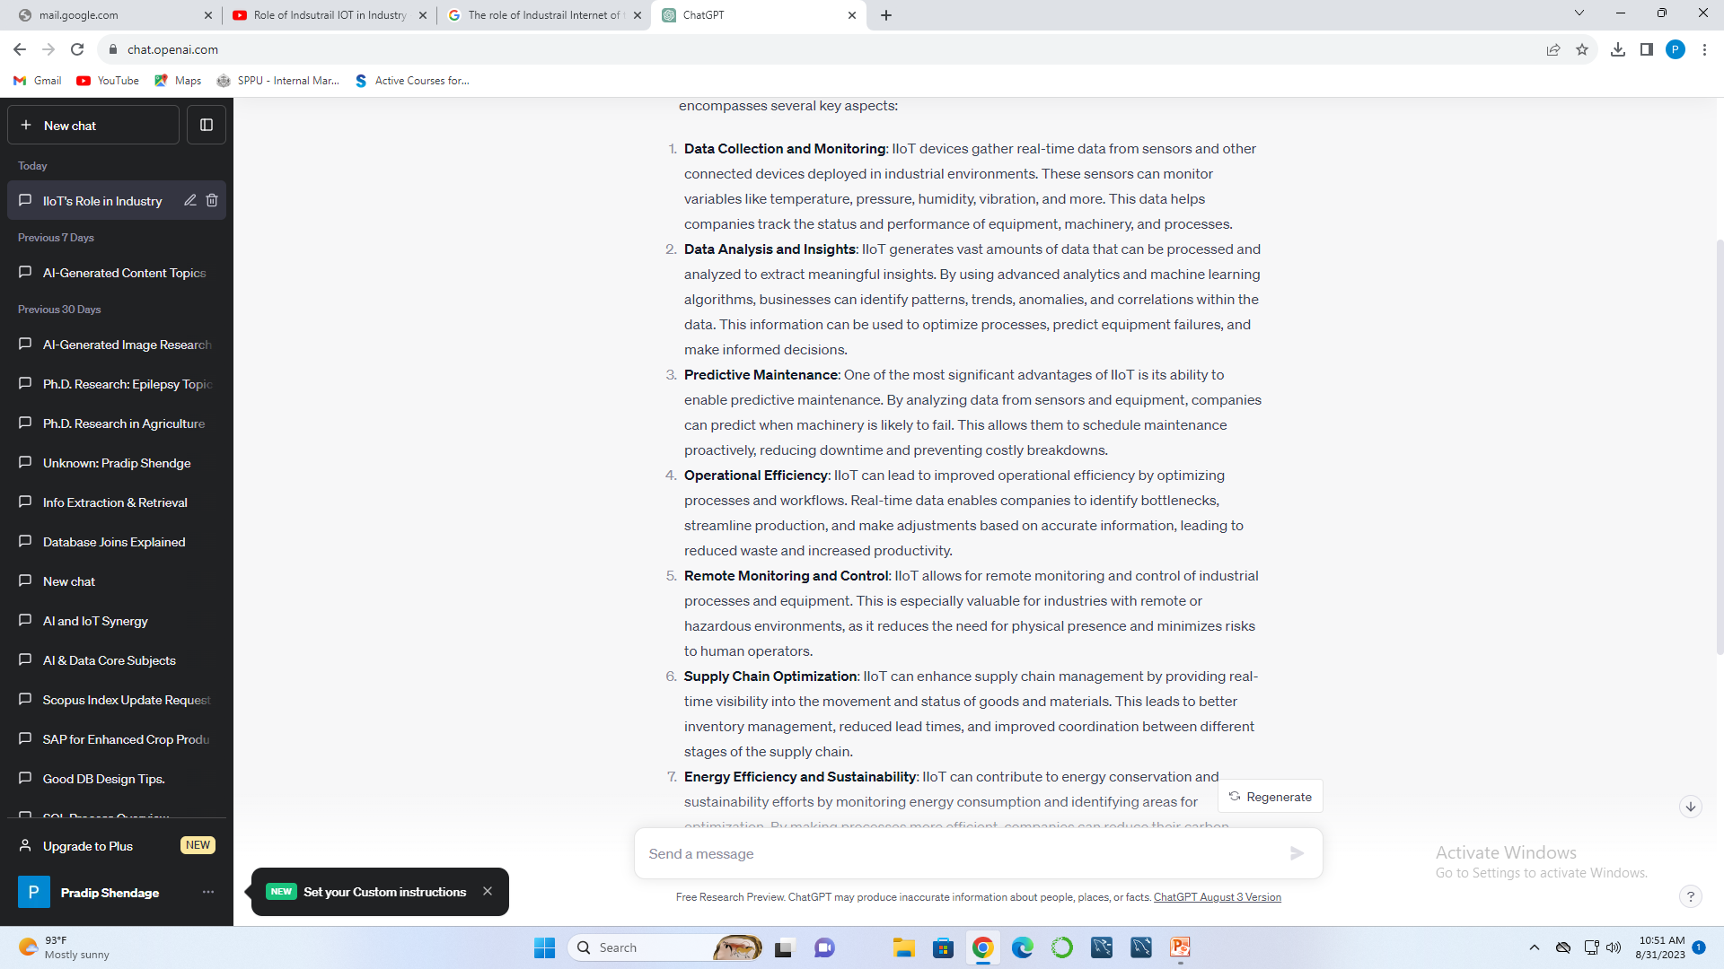
The Role of Industrial IOT

Slide 34
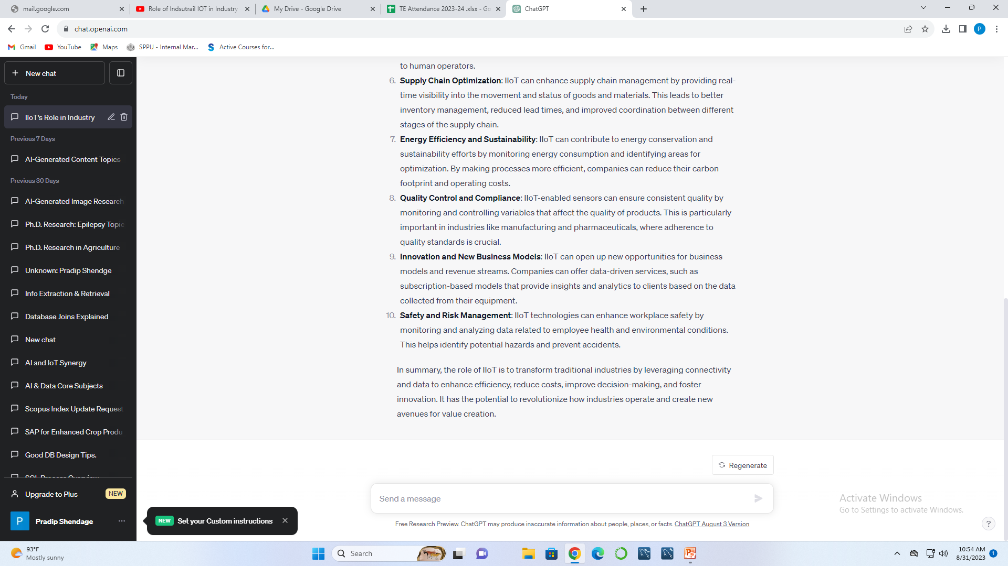

Slide 36
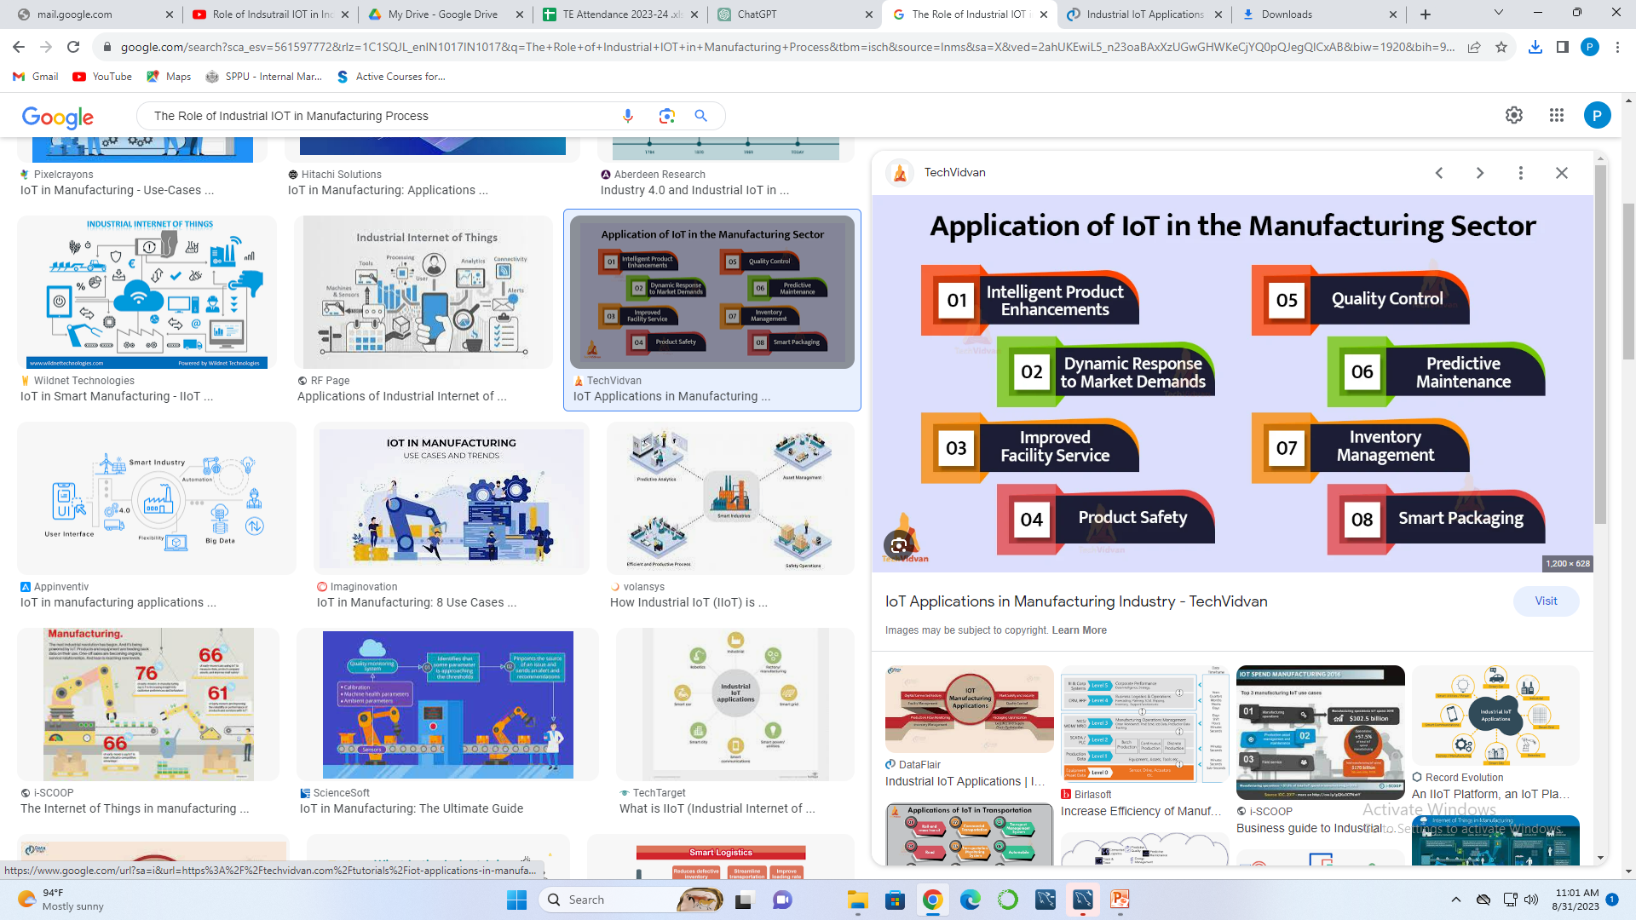
The Role of Industrial IOT in Manufacturing Process

Slide 37
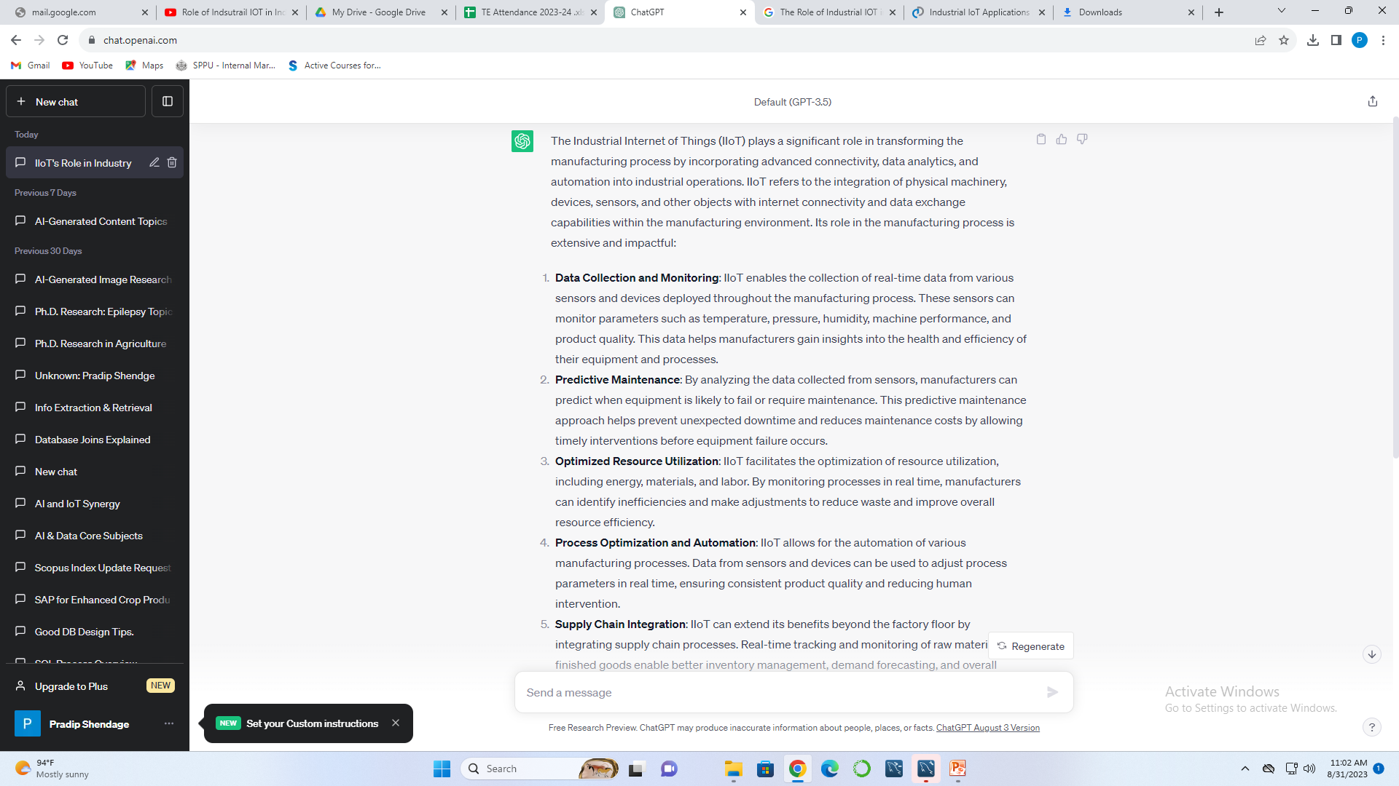
The Role of Industrial IOT in Manufacturing Process

Slide 38
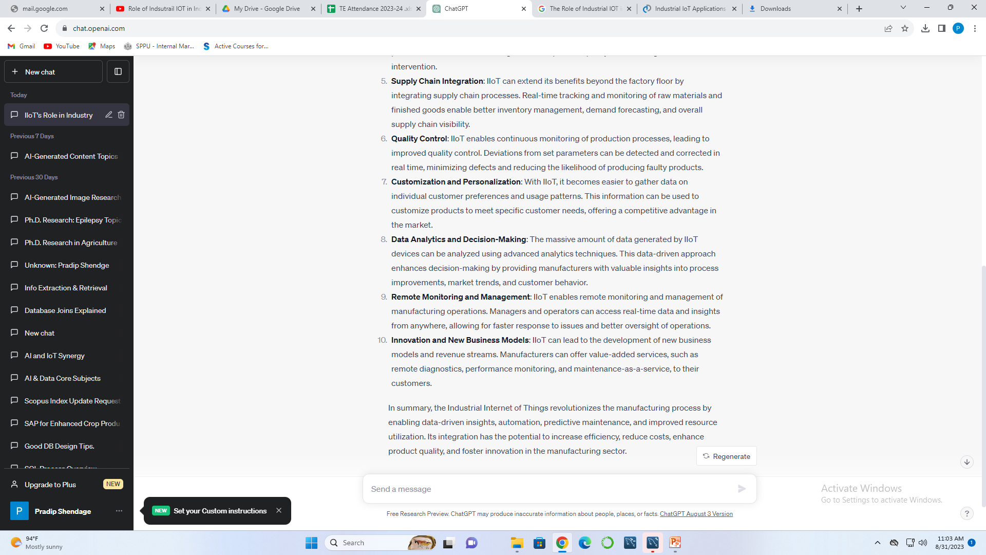

Slide 39


Slide 40
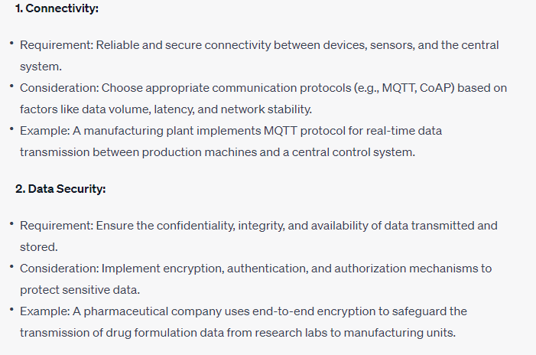
IIOT Requirements & Design Consideration

Slide 41
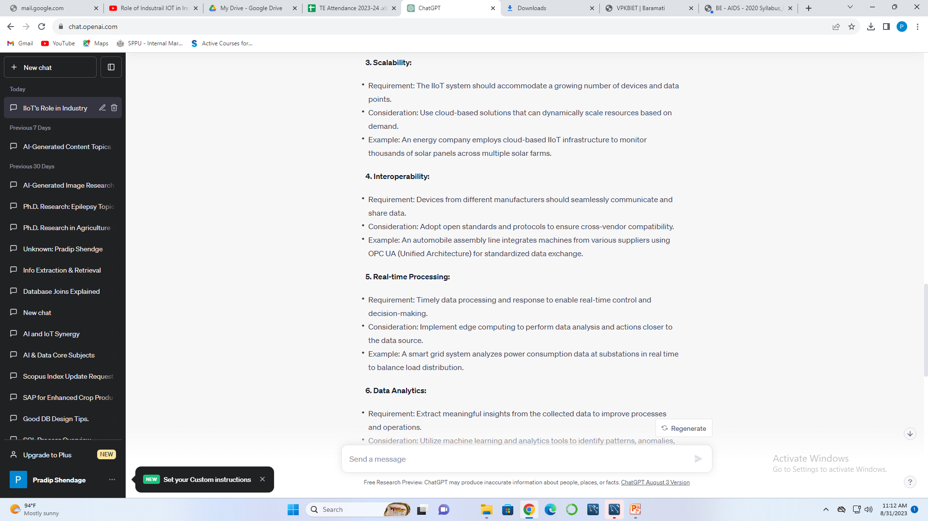
IIOT Requirements & Design Consideration

Slide 42
IIOT Requirements & Design Consideration

Slide 43


Slide 44


Slide 45


Slide 46
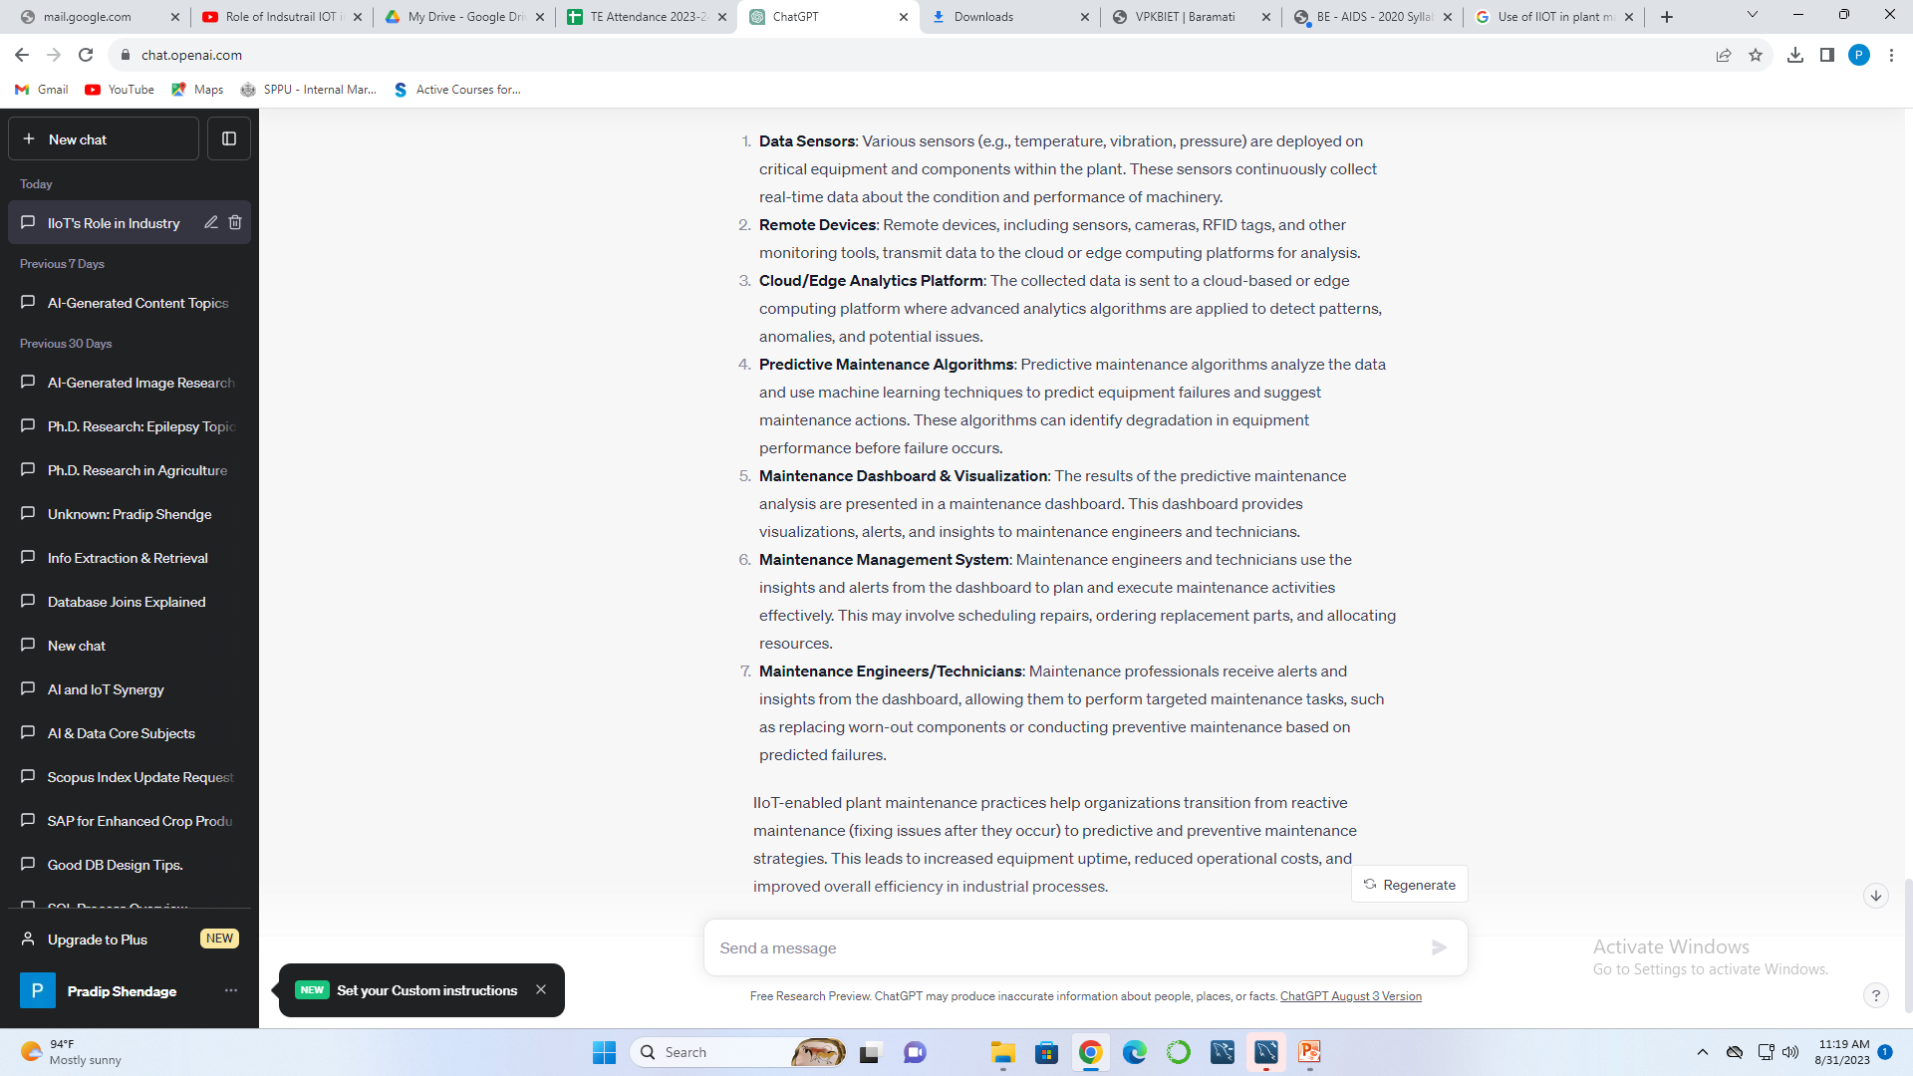
Use of IIOT in plant maintenance practices

Slide 47

Use of IIOT in plant maintenance practices

Slide 48

Key Opportunities

Slide 49
Key Opportunities

Slide 50

Challenges

Slide 51
Application of IIOT
Industrial Automation – Improving Efficiency and Accuracy of Processes
Autonomous Vehicles – Decrease the Load on Human Workforce
Predictive Maintenance – Reducing Risk With Timely Upkeep of Machines
Futuristic Farming – Improving the Yield with Better Monitoring of Farmland
Aerospace – Increasing Safety in Airplanes
Smart Logistics – Quicker and More efficient shipments
Wearables – Improving Worker Efficiency
Energy Networks – Improving Energy Utilization

